Slide 1
News Search Engine (Information Retrival Project) Sepehr Asgarian

Slide 2

RoadMap
Introduction
A short introduction
How this Search engine work
Steps
Preprocess
+
Posting list
+
TF-IDF
Code
Implementation
Search Engine
What is this project about
+
+
Results

Slide 3
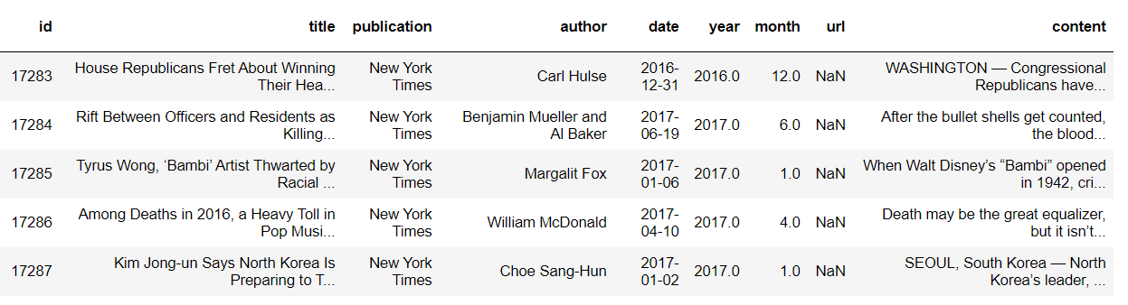
Introduction
What is the project about
Dataset
https://www.kaggle.com/snapcrack/all-the-news
Fig.1

Slide 4
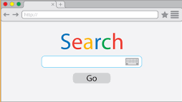
Search Engine
How this Search Engine work?
Preprocessing
Posting list
TF_IDF
Elimination index
Champion list
Fig.2

Slide 5
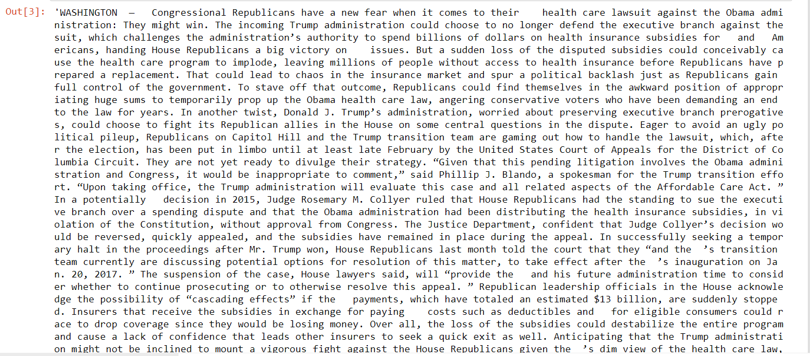
Steps
Preprocess
Fig.3

Slide 6
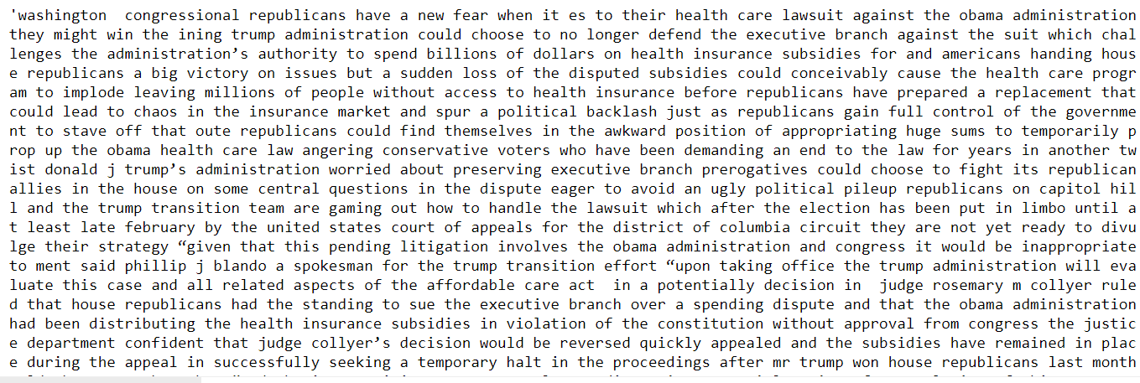
Steps
After a simple Preprocess
Fig.4

Slide 7
Steps
Preprocess
Tokenization
Remove Stop words
Stemming and lemmatization
Fig.4

Slide 8
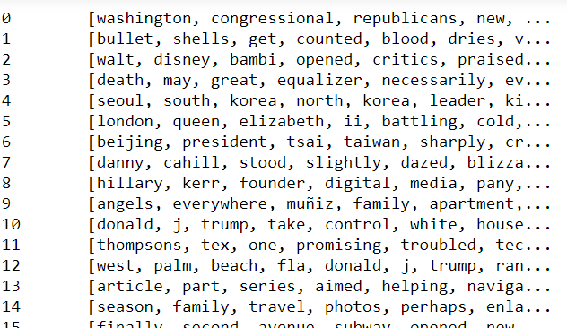
Steps
After Preprocess
Fig.5

Slide 9
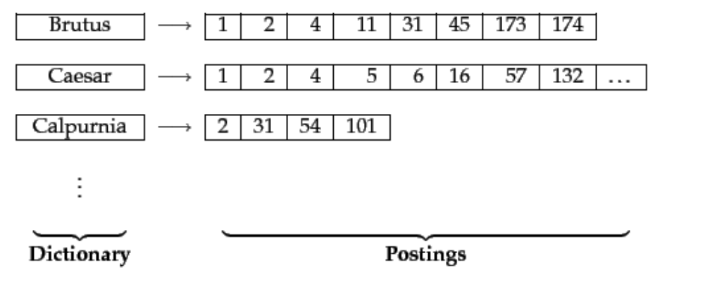
Steps
Posting list
Fig6[1]

Slide 10
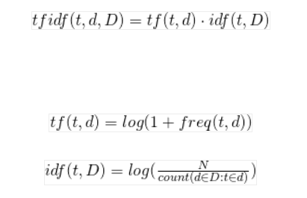
Steps
TF_IDF
Fig7[2]

Slide 11
let's start our search engine

Slide 12
Thank You for your Attention!

Slide 13
References
[1] Jeremy Jordan, “Introduction to autoencoders.,” Jeremy Jordan, 19-Mar-2018. [Online]. Available: https://www.jeremyjordan.me/autoencoders/
[2] Auto-Encoder: What Is It? And What Is It Used For? (Part 1)
Will Badr, https://towardsdatascience.com/auto-encoder-what-is-it-and-what-is-it-used-for-part-1-3e5c6f017726
[3]Autoencoder example .Copy right by kirill eremenko(Deep learning A_Z : Hands-on Artificial Neural Networks)
[4] Seyrek Otomatik Kodlayıcı (Sparse Autoencoder)
Author: veribilimcisi, https://veribilimcisi.com/2018/06/04/seyrek-otomatik-kodlayici-sparse-autoencoder
[5] Applied Deep Learning - Part 3: Autoencoders
Arden Dertat, https://towardsdatascience.com/applied-deep-learning-part-3-autoencoders-1c083af4d798.
[6] Chaudhary, “A High-Level Guide to Autoencoders,” Medium, 22-Aug-2019. [Online]. Available: https://towardsdatascience.com/a-high-level-guide-to-autoencoders-b103ccd45924

